Slide 1



CELLULA TECHNOLOGIES • ML INTERNSHIP PROGRAM
Time Series Forecasting
Task 5 — Preprocessing, ARIMA/SARIMA & Bonus LSTM/RNN
Continuing directly from Task 4’s cleaned Damietta weather series — stationarity-tested, modeled with SARIMAX + annual Fourier terms, forecast with confidence intervals, and benchmarked against naive and deep-learning baselines.
731
90d
SARIMAX
Daily observations
Held-out test window
Core forecasting model
Prepared by Ahmed Elghrably
Input: damietta_2024_2025_clean.csv
AI & ML Engineering Student, Damietta University
731 rows • 2024–2025

Slide 2



Preprocessing Pipeline
03
Five steps from raw daily series to a model-ready, leakage-free train/test split.
1
2
3
4
5
Resample & Align
Missing Values
Outlier Treatment
Feature Engineering
Time-Aware Split
asfreq('D') confirms sorted, gap-free daily index — 0 missing rows
Time-aware interpolation (general-purpose; no-op on this gap-free set)
30-day rolling z-score (|Z|>2.5), seasonal not global — 2 mild flags, none dropped
Lags t-1/t-7/t-365, 7-/30-day rolling stats, day-of-year sin/cos
Chronological cutoff — last 90 days held out, never shuffled
SPLIT RESULT
Train: 641 days (2024-01-01 → 2025-10-02) Test: 90 days (2025-10-03 → 2025-12-31)
Scaling: ARIMA/SARIMAX models the raw/differenced series directly (no scaling). RNN/LSTM use MinMaxScaler fit on train only, applied to both splits (§6).
Damietta Weather Analytics • Task 5: Time-Series Forecasting
03

Slide 3

Stationarity Checks
04
ADF and KPSS have opposite null hypotheses — agreement between them is a stronger signal than either test alone.
Series
ADF (stat / p)
KPSS (stat / p)
Verdict
Raw temperature
-1.38 / 0.593
0.540 / 0.033
NON-stationary
First difference (d=1)
-15.83 / 0.000
0.133 / 0.100
Stationary
VERDICT
ADF and KPSS agree: the raw series is non-stationary, and a single first difference (d=1) is enough to pass both tests. The remaining annual structure is handled with Fourier exogenous regressors in §5, not a literal seasonal difference — diff(365) alone would leave only 276 of 641 training rows.
Damietta Weather Analytics • Task 5: Time-Series Forecasting
04

Slide 4
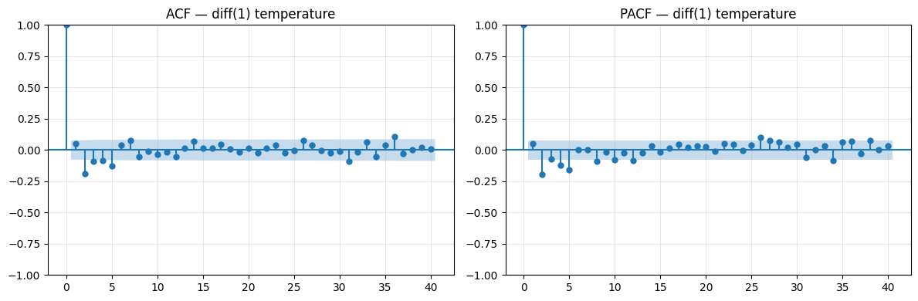
Model Selection
05
Annual seasonality via Fourier exogenous terms; non-seasonal order chosen by auto_arima.
ANNUAL SEASONALITY → FOURIER TERMS
K=3 harmonics of sin/cos(2π·k·day-of-year/365.25), passed as exogenous regressors so auto_arima only searches the non-seasonal (p,d,q) for the leftover errors.
CHOSEN ORDER
SARIMAX(2, 1, 2)
Only the K=1 harmonic (sin_1, cos_1) is significant (p<0.001) — the annual cycle is close to a single sine wave; K=2,3 add little.
ACF / PACF on the first-differenced series — both decay gradually rather than cutting off sharply, consistent with a mixed ARMA(p,q).
MODEL FIT (train, n=641)
1483.9
1532.9
−730.9
AIC
BIC
Log-Lik.
Damietta Weather Analytics • Task 5: Time-Series Forecasting
05

Slide 5
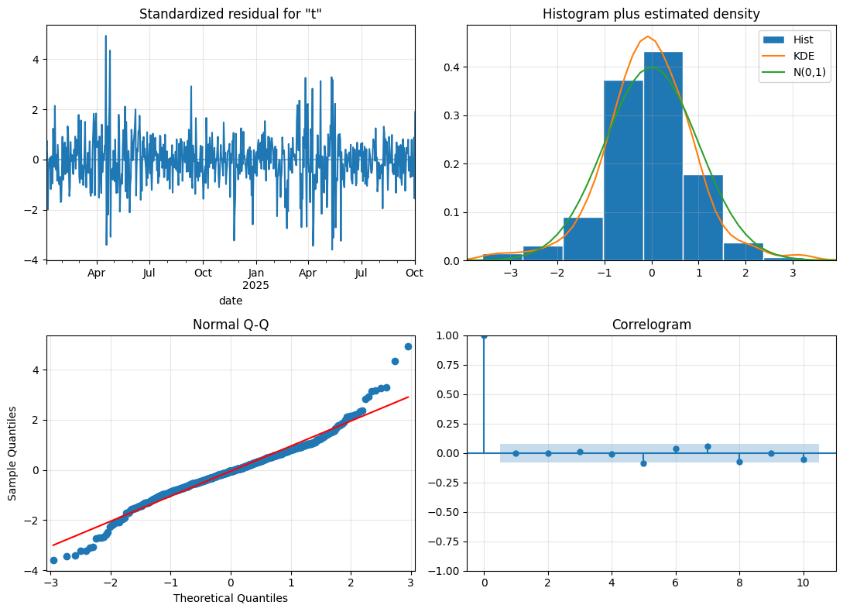
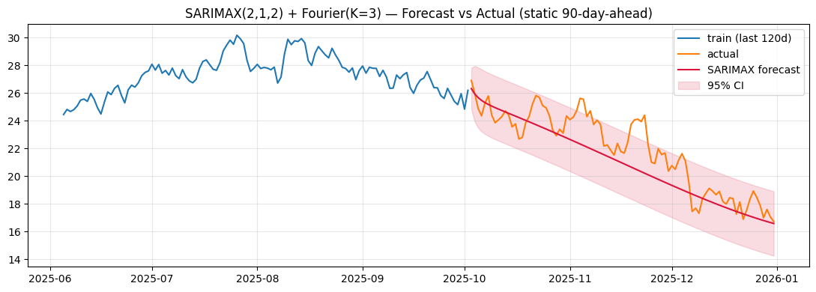
Residual Diagnostics & Forecast
06
LJUNG-BOX (RESIDUAL AUTOCORRELATION)
plot_diagnostics(): standardized residuals, histogram vs. N(0,1), Q-Q plot, correlogram.
lag 10: p=0.029 (borderline) lag 20: p=0.256 lag 30: p=0.635
Residuals are close to white noise at 20/30 lags; Q-Q shows fatter tails than Gaussian (occasional cold-snap jumps) — point forecasts are trustworthy, 95% CIs may be a touch narrow on the tails.
Damietta Weather Analytics • Task 5: Time-Series Forecasting
06

Slide 6

Evaluation — Metrics vs. Baselines
07
Static 90-day-ahead forecast, scored against two naive baselines the brief itself recommends keeping.
Persistence
Seasonal-Naive
SARIMAX (static 90d)
0.62°C
1.44°C
1.24°C
MAE • RMSE 0.76 • MAPE 2.89%
MAE • RMSE 1.76 • MAPE 6.60%
MAE • RMSE 1.56 • MAPE 5.53%
tomorrow = today — hard to beat given day-to-day autocorrelation
today = same date last year
single-origin forecast, no new information to update on over 90 days
Honest result: at this static 90-day horizon, plain persistence beats SARIMAX — exactly what the brief’s “keep a naive baseline” advice is designed to catch. Not a bug: a single far-off forecast has nothing new to update on and decays toward the deterministic seasonal curve. Tested at a realistic horizon next →
Damietta Weather Analytics • Task 5: Time-Series Forecasting
07

Slide 7
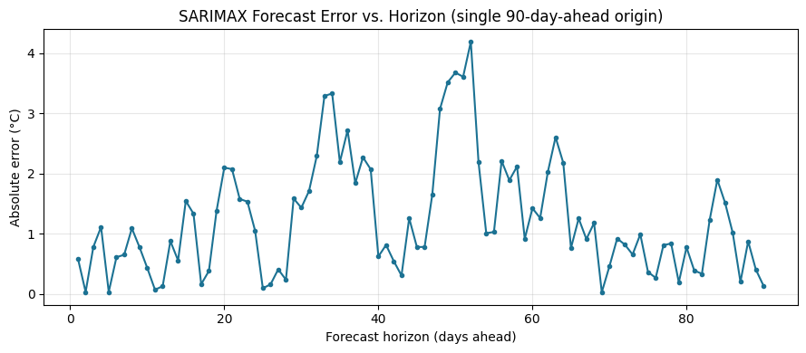
Walk-Forward Validation
08
Refitting on 5 rolling 14-day folds — a more realistic test than one static 90-day-ahead forecast.
Fold
Train ends
Test window
MAE
1
...10-22
10-23 → 11-05
1.223
2
...11-05
11-06 → 11-19
0.719
3
...11-19
11-20 → 12-03
1.133
4
...12-03
12-04 → 12-17
0.851
5
...12-17
12-18 → 12-31
0.533
WALK-FORWARD MEAN
0.89°C (±0.26)
Error grows from ~0.5°C at t+1 to a peak around t+50–60, then plateaus — confirms SARIMAX is a far stronger short-horizon forecaster than the static view alone suggests.
Much closer to persistence’s 0.62°C than the static 90-day view suggested — the earlier gap was mostly a horizon artifact.
Damietta Weather Analytics • Task 5: Time-Series Forecasting
08

Slide 8
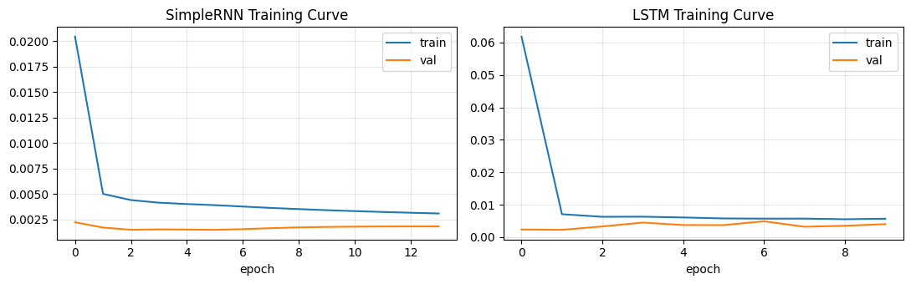
Bonus: RNN & LSTM Forecasting
09
30-day lookback windows, MinMaxScaler fit on train only — a statistical model vs. two deep-learning approaches.
WHAT IT MEANS
MinMaxScaler fit on the training split only, then applied to test — avoids scaler leakage.
Predictions inverse-transformed before computing MAE/RMSE — metrics report in °C, not [0,1].
TRAINING CURVES (early stopping, patience=8)
SimpleRNN (0.85°C) outperforms LSTM (1.31°C): with only ~610 training windows, the larger two-layer LSTM+Dropout stack has more capacity than the data can support.
SimpleRNN
MAE = 0.85°C
stopped @ epoch 14
RMSE 1.08 • MAPE 4.03%
Both networks predict one step ahead from known past values — no recursive drift in this evaluation.
LSTM (2-layer + Dropout)
MAE = 1.31°C
stopped @ epoch 10
RMSE 1.55 • MAPE 6.30%
Damietta Weather Analytics • Task 5: Time-Series Forecasting
09

Slide 9
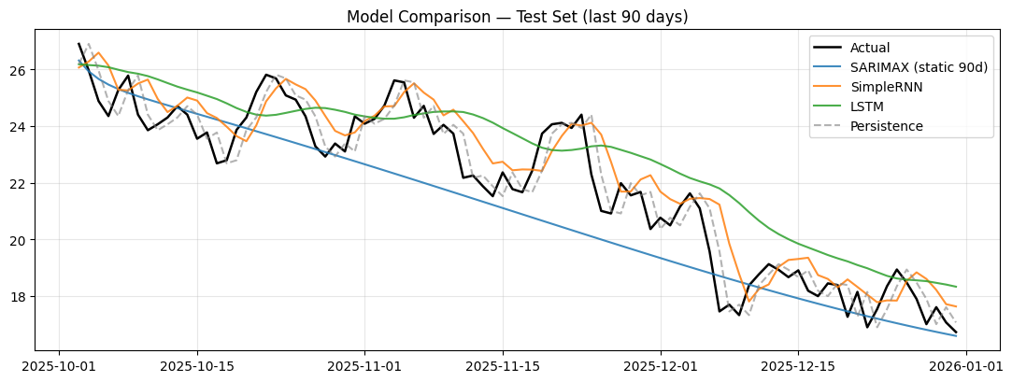
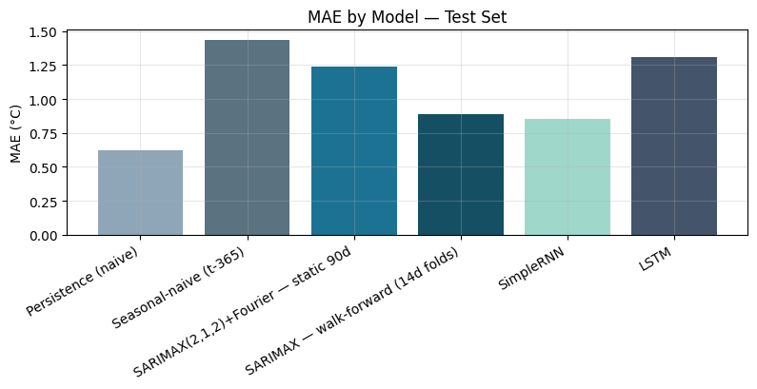
Model Comparison
10
All models scored on the same 90-day test window and metrics.
Model
MAE
RMSE
MAPE (%)
Notes
Persistence (naive)
0.62
0.76
2.89
Hardest baseline to beat
Seasonal-naive (t-365)
1.44
1.76
6.60
SARIMAX — static 90d
1.24
1.56
5.53
Weakest at this horizon
SARIMAX — walk-forward 14d
0.89
—
—
Much stronger short-horizon
SimpleRNN
0.85
1.08
4.03
Best learned model
LSTM
1.31
1.55
6.30
Underfit — limited data
Damietta Weather Analytics • Task 5: Time-Series Forecasting
10

Slide 10
CONCLUSION
No model wins outright —
it depends on the horizon.
Static 90-day-ahead: persistence (0.62°C) beats every model built here, including SARIMAX (1.24°C) and LSTM (1.31°C).
Realistic 14-day walk-forward: SARIMAX drops to 0.89°C — the earlier gap was mostly a horizon artifact, not an unfit model.
SimpleRNN (0.85°C) was the best-performing learned model; the larger LSTM (1.31°C) underfit with only ~610 training windows.
Practical takeaway: SARIMAX’s real strength is a full 90-day seasonal trajectory with calibrated confidence intervals — something no naive or neural baseline provides out of the box.
DELIVERABLES CHECKLIST
✓ Cleaned, gap-free series with documented preprocessing ✓ ADF + KPSS stationarity results, justified ✓ ACF/PACF + auto_arima order ✓ Residual diagnostics + Ljung-Box ✓ Forecast with 95% CI ✓ MAE/RMSE/MAPE + walk-forward scores ✓ Bonus LSTM/RNN pipeline & comparison
Damietta Weather Analytics & Time-Series Forecasting — Cellula Technologies ML Internship Program, Task 5
11

